Slide 1
问题求解智能体

Slide 2
大纲
问题求解智能体
问题形式化
无信息的搜索
有信息的搜索
博弈论

Slide 3
Example: Measuring problem!
9 l
5 l
3 l
Problem: Using these three buckets,
measure 7 liters of water.

Slide 4
Example: Measuring problem!
(one possible) Solution:
a b c
0 0 0 start
3 0 0
0 0 3
3 0 3
0 0 6
3 0 6
0 3 6
3 3 6
1 5 6
0 5 7 goal
9 l
5 l
3 l
a
b
c

Slide 5
Example: Measuring problem!
(one possible) Solution:
a b c
0 0 0 start
3 0 0
0 0 3
3 0 3
0 0 6
3 0 6
0 3 6
3 3 6
1 5 6
0 5 7 goal
9 l
5 l
3 l
a
b
c

Slide 6
Example: Measuring problem!
(one possible) Solution:
a b c
0 0 0 start
3 0 0
0 0 3
3 0 3
0 0 6
3 0 6
0 3 6
3 3 6
1 5 6
0 5 7 goal
9 l
5 l
3 l
a
b
c

Slide 7
Example: Measuring problem!
(one possible) Solution:
a b c
0 0 0 start
3 0 0
0 0 3
3 0 3
0 0 6
3 0 6
0 3 6
3 3 6
1 5 6
0 5 7 goal
9 l
5 l
3 l
a
b
c

Slide 8
Example: Measuring problem!
(one possible) Solution:
a b c
0 0 0 start
3 0 0
0 0 3
3 0 3
0 0 6
3 0 6
0 3 6
3 3 6
1 5 6
0 5 7 goal
9 l
5 l
3 l
a
b
c

Slide 9
Example: Measuring problem!
(one possible) Solution:
a b c
0 0 0 start
3 0 0
0 0 3
3 0 3
0 0 6
3 0 6
0 3 6
3 3 6
1 5 6
0 5 7 goal
9 l
5 l
3 l
a
b
c

Slide 10
Example: Measuring problem!
(one possible) Solution:
a b c
0 0 0 start
3 0 0
0 0 3
3 0 3
0 0 6
3 0 6
0 3 6
3 3 6
1 5 6
0 5 7 goal
9 l
5 l
3 l
a
b
c

Slide 11
Example: Measuring problem!
(one possible) Solution:
a b c
0 0 0 start
3 0 0
0 0 3
3 0 3
0 0 6
3 0 6
0 3 6
3 3 6
1 5 6
0 5 7 goal
9 l
5 l
3 l
a
b
c

Slide 12
Example: Measuring problem!
(one possible) Solution:
a b c
0 0 0 start
3 0 0
0 0 3
3 0 3
0 0 6
3 0 6
0 3 6
3 3 6
1 5 6
0 5 7 goal
9 l
5 l
3 l
a
b
c

Slide 13
Example: Measuring problem!
(one possible) Solution:
a b c
0 0 0 start
3 0 0
0 0 3
3 0 3
0 0 6
3 0 6
0 3 6
3 3 6
1 5 6
0 5 7 goal
9 l
5 l
3 l
a
b
c

Slide 14
Example: Measuring problem!
Another Solution:
a b c
0 0 0 start
0 5 0
0 0 3
3 0 3
0 0 6
3 0 6
0 3 6
3 3 6
1 5 6
0 5 7 goal
9 l
5 l
3 l
a
b
c

Slide 15
Example: Measuring problem!
Another Solution:
a b c
0 0 0 start
0 5 0
3 2 0
0 0 3
3 0 3
0 0 6
3 0 6
0 3 6
3 3 6
1 5 6
0 5 7 goal
9 l
5 l
3 l
a
b
c

Slide 16
Example: Measuring problem!
Another Solution:
a b c
0 0 0 start
0 5 0
3 2 0
3 0 2
3 0 3
0 0 6
3 0 6
0 3 6
3 3 6
1 5 6
0 5 7 goal
9 l
5 l
3 l
a
b
c

Slide 17
Example: Measuring problem!
Another Solution:
a b c
0 0 0 start
0 5 0
3 2 0
3 0 2
3 5 2
0 0 6
3 0 6
0 3 6
3 3 6
1 5 6
0 5 7 goal
9 l
5 l
3 l
a
b
c

Slide 18
Example: Measuring problem!
Another Solution:
a b c
0 0 0 start
0 5 0
3 2 0
3 0 2
3 5 2
3 0 7 goal
3 0 6
0 3 6
3 3 6
1 5 6
0 5 7 goal
9 l
5 l
3 l
a
b
c

Slide 19
Which solution do we prefer?
Solution 1:
a b c
0 0 0 start
3 0 0
0 0 3
3 0 3
0 0 6
3 0 6
0 3 6
3 3 6
1 5 6
0 5 7 goal
Solution 2:
a b c
0 0 0 start
0 5 0
3 2 0
3 0 2
3 5 2
3 0 7 goal

Slide 20
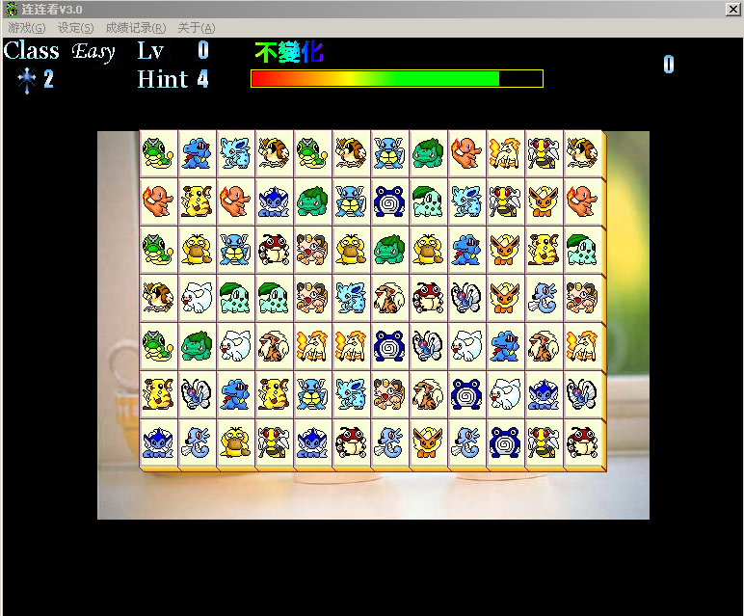
例：连连看
环境
环境大小: 12 * 7
方块类型: 21种 * 4块
行动
连接两个相同的动物方块，并删除它们
性能和目标
删除所有的方块
时间最少

Slide 21
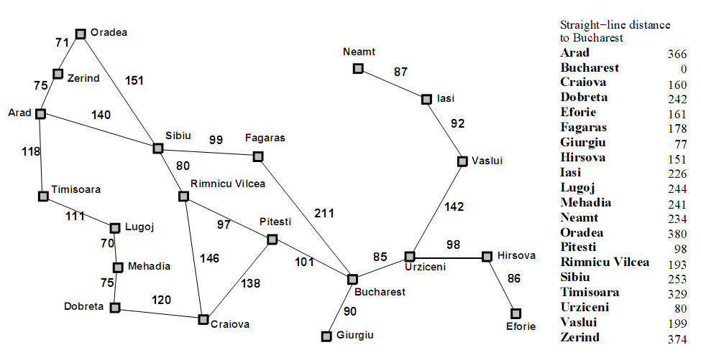
例：旅行

Slide 22
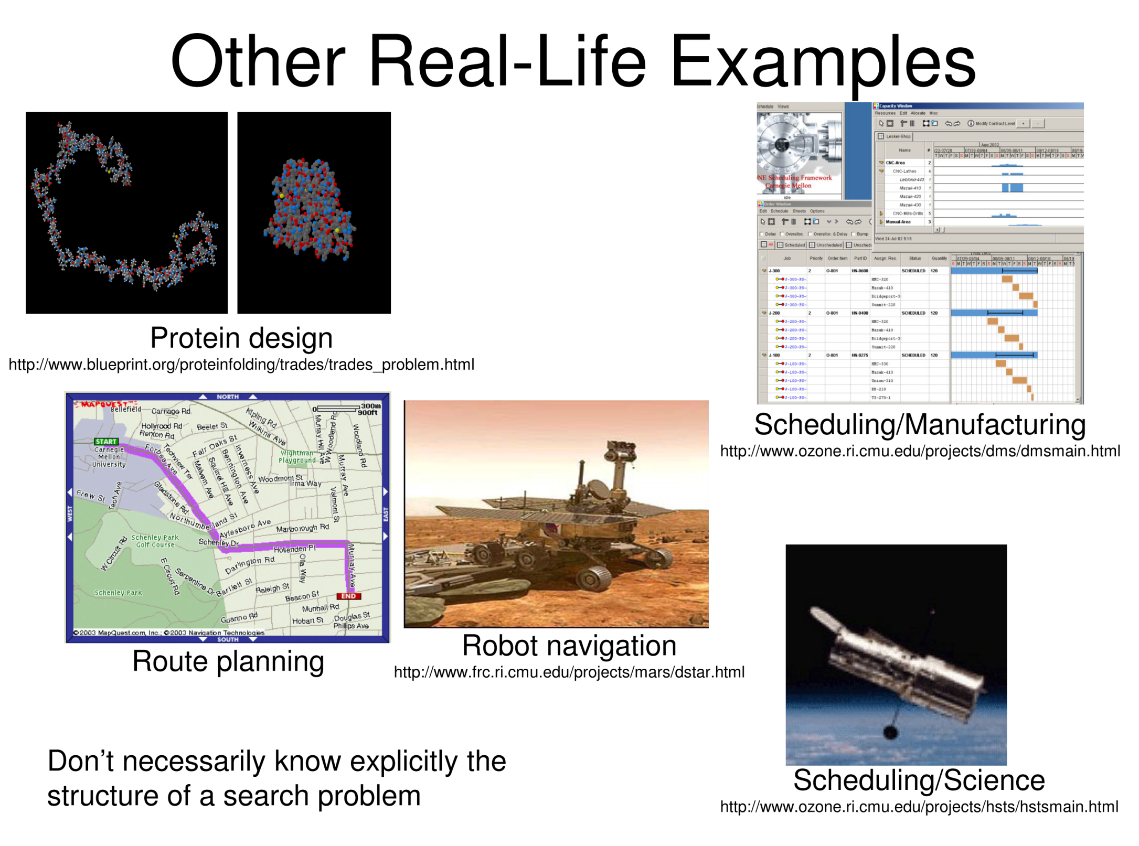

Slide 23
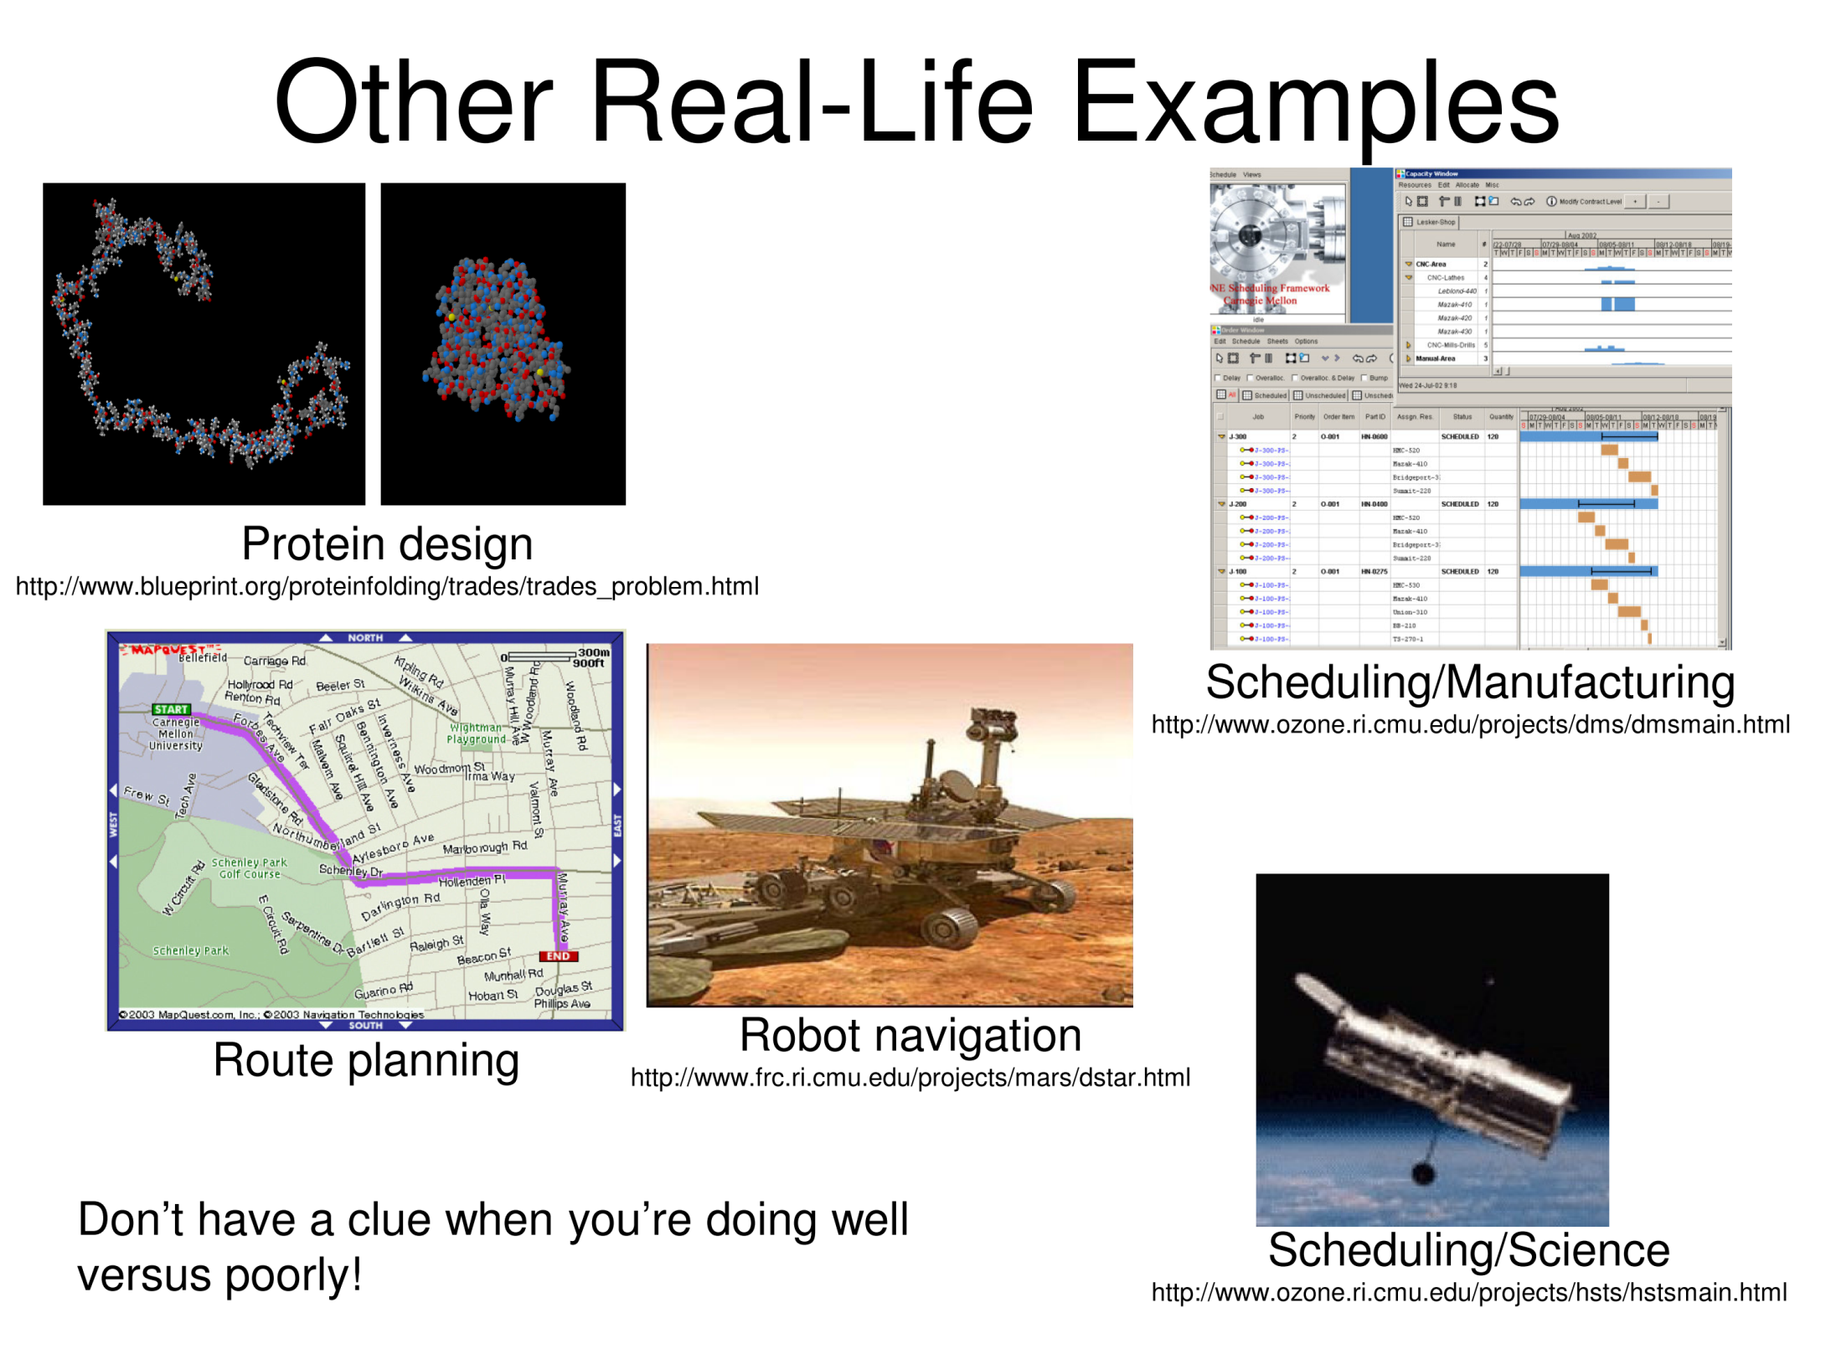

Slide 24
问题求解智能体
一种基于目标的智能体
三个步骤
问题形式化
搜索（ Search）
执行（Execute ）
Notes:
Ttt,t,b

Slide 25
Selecting a state space
Real world is absurdly complex
→ state space must be abstracted for problem solving
(Abstract) state = set of real states
(Abstract) action = complex combination of real actions
“Arad → Zerind” represents a complex set of possible routes, detours(繞路而行), rest stops, etc.
For guaranteed realizability, any real state "in Arad“ must get to some real state "in Zerind“
(Abstract) solution = set of real paths that are solutions in the real world
Each abstract action should be "easier" than the original problem

Slide 26
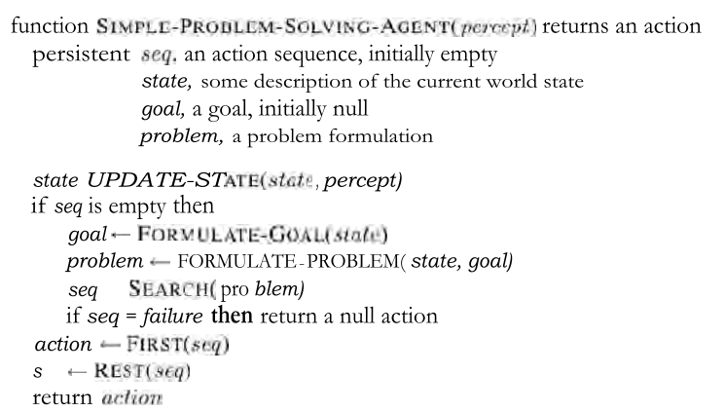
該函數需要反復執行，直至達到目標。

Slide 27
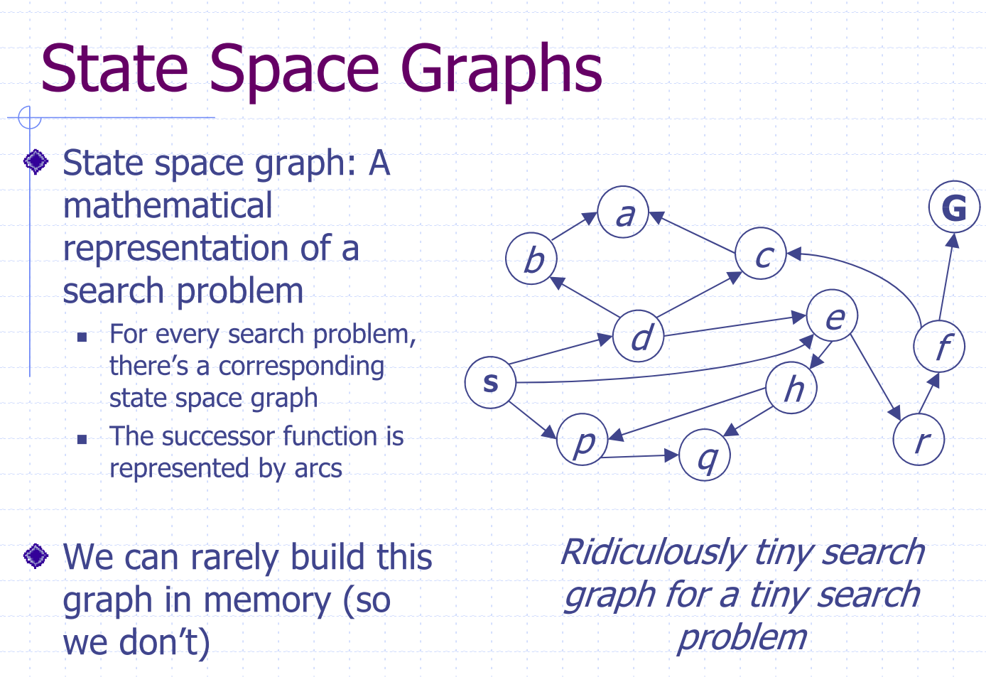

Slide 28
Environment Types
Static
Observable
the agent always knows the current state
Discrete
at any given state there are only finitely many actions to choose from
Deterministic
each action has exactly one outcome

Slide 29
问题形式化
问题分为四个元素
初始状态
如： "at Arad“
后续函数 S(x) = 行动-状态对集合
如： S(Arad) = {(Go(Sibiu),In(Sibiu)), (Go(Timisoara), In( Timisoara))…}
目标测试
明确的, x = At(Bucharest)
含糊的, Checkmate(x)
路径耗散
如：距离的和、行动的数量等

Slide 30
问题形式化
问题的解
从初始状态到目标状态的行动序列
解的质量由路径耗散函数度量
最优解（ optimal solution ）
具有最低路径耗散的解

Slide 31
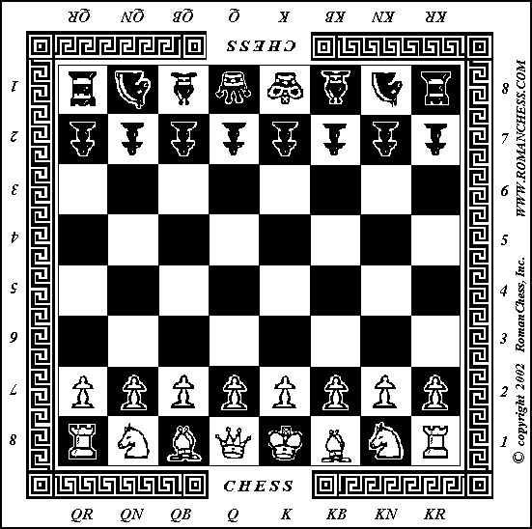
例: 国际象棋
初始状态
后续函数
移动棋子
目标测试
Checkmate：判断谁赢
路径耗散
步数、时间

Slide 32
例：旅游
初始状态
起始城市
后续函数
从一个城市到另一城市
目标测试
到达目的地？
路径耗散
路上的时间或者路程
Liverpool
Leeds
Nottingham
Manchester
Birmingham
London

Slide 33
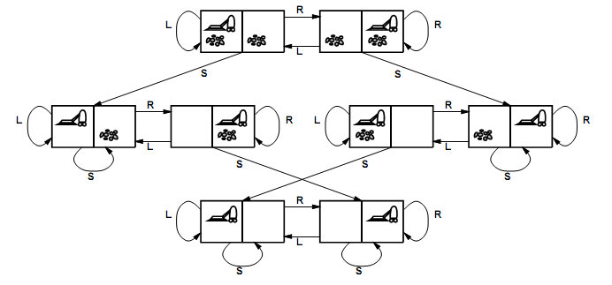
Vacuum world state space graph
states?
actions?
goal test?
path cost?
Combination of dirt and robot locations
Left, Right, Suck
no dirt at all locations
1 per action

Slide 34

Example: The 8-puzzle
states?
actions?
goal test?
path cost?
locations of tiles (9! / 2 = 181440, for 15-puzzle, 1.3 * 10¹² States)
move blank left, right, up, down
goal state (given)
1 per move

Slide 35
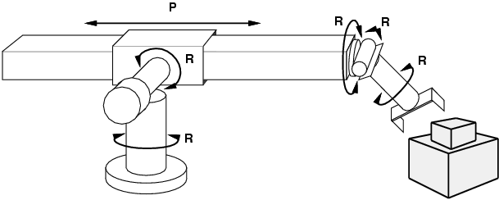
Example: robotic assembly
states: real-valued coordinates of robot joint angles, together with the parts of the object to be assembled
actions: continuous motions of robot joints
goal test: complete assembly
path cost: time to execute

Slide 36
無限狀態空間的例子
從數字4出發，應用一系列函數（可重複應用）：階乘，平方根，下取整，可以得到任何一個正整數。
狀態：正整數
初始狀態：4
動作：應用階乘，平方根，下取整函數
目標測試：是否為欲獲得之整數
620,448,401,733,239,439,360,000

Slide 37
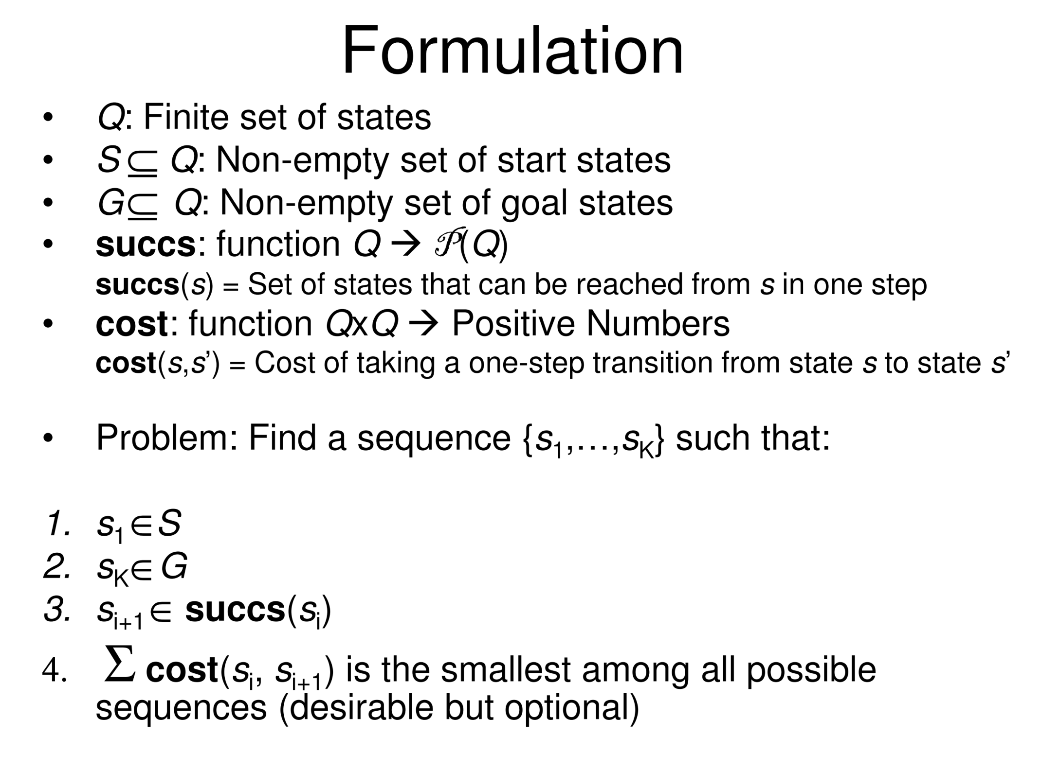

Slide 38
通过搜索解决问题
搜索
检查不同的行动序列（解），选择最好解的过程
这是传统问题求解方法中最直接的方法
通常是通过树型(Tree)结构来进行

Slide 39
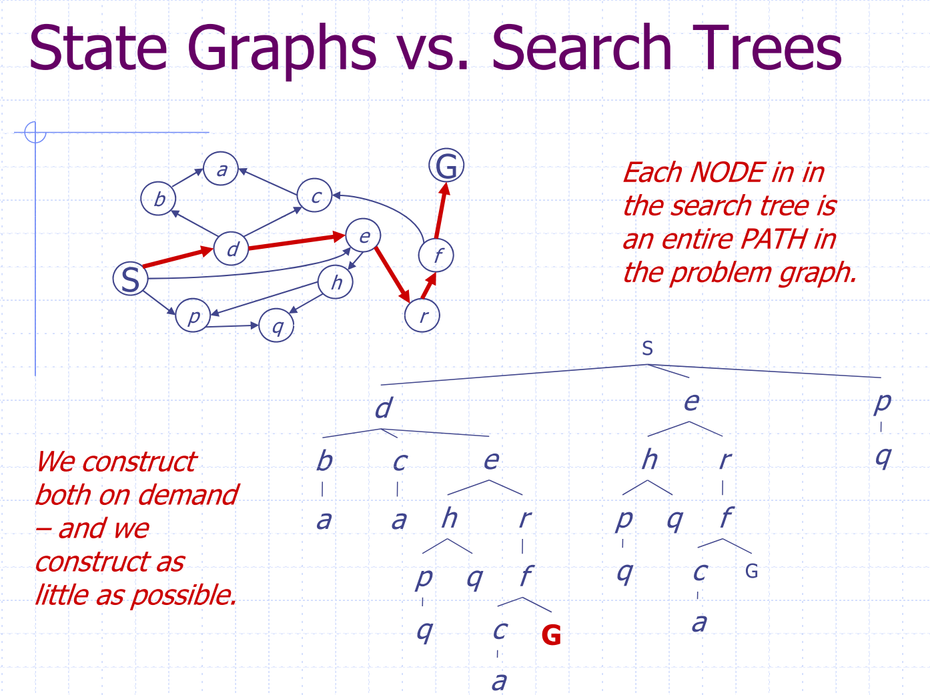

Slide 40
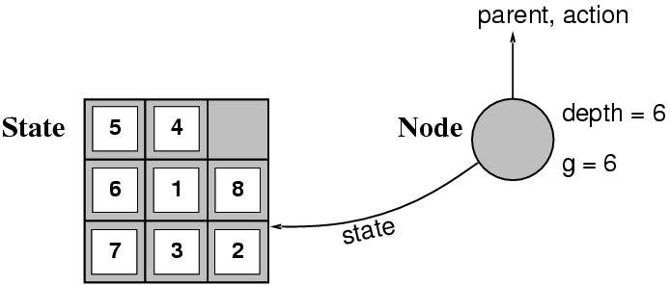
Implementation: states vs. nodes
A state is a (representation of) a physical configuration
A node is a data structure constituting part of a search tree includes state, parent node, action, path cost g(x), depth
The Expand function creates new nodes, filling in the various fields and using the SuccessorFn of the problem to create the corresponding states.

Slide 41
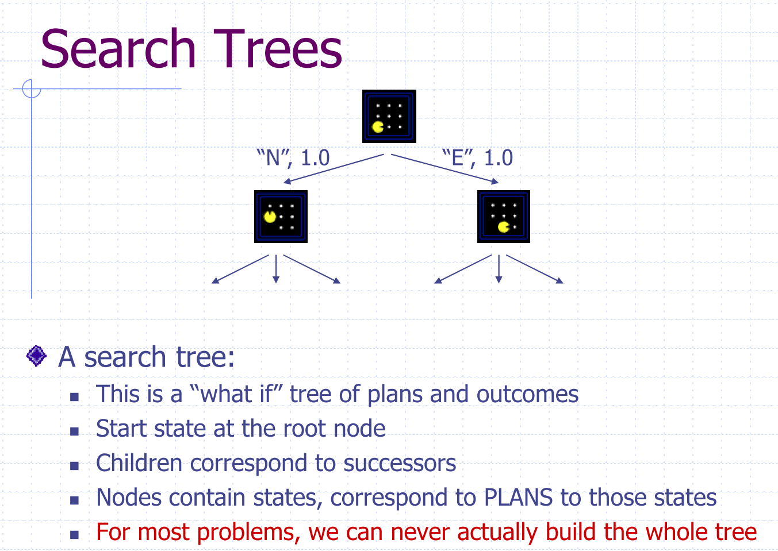

Slide 42
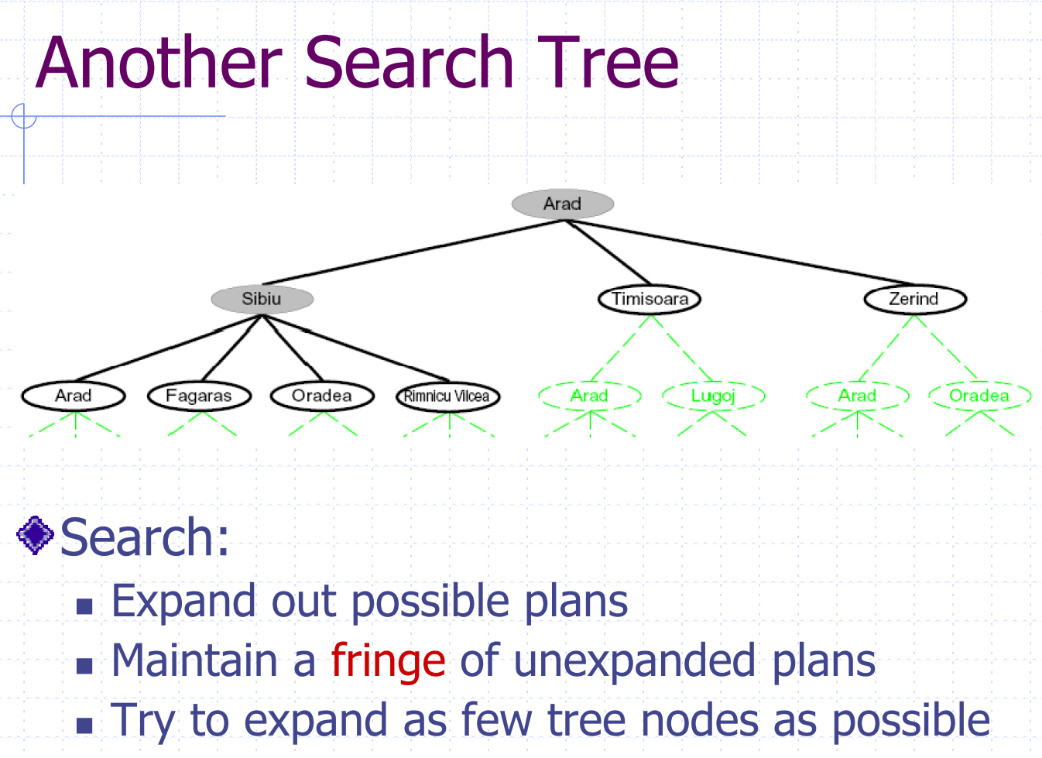

Slide 43
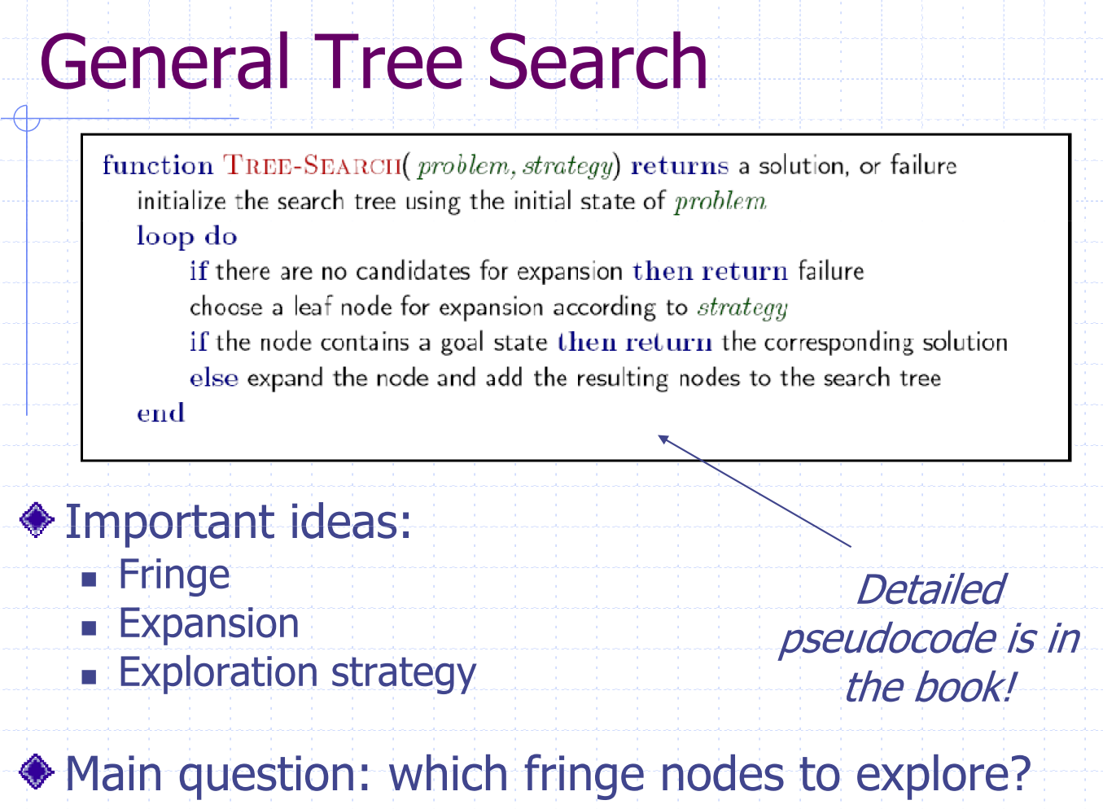
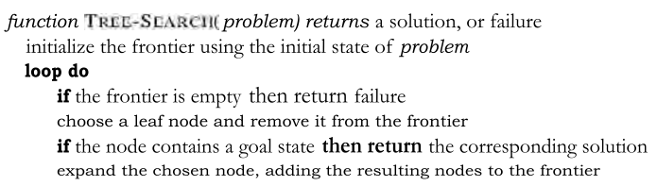

Slide 44
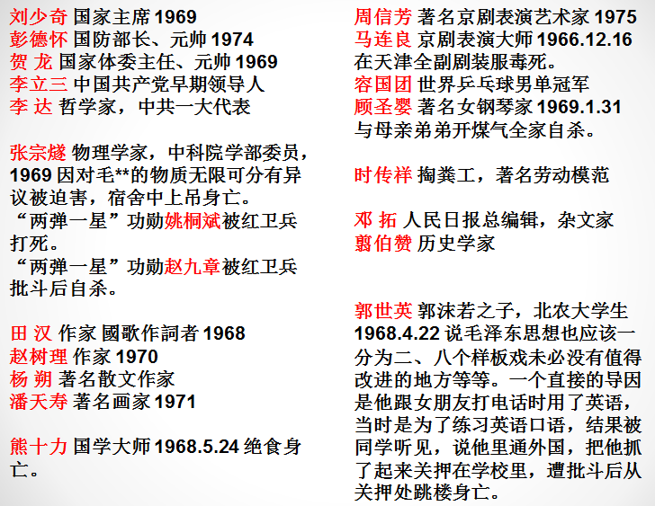
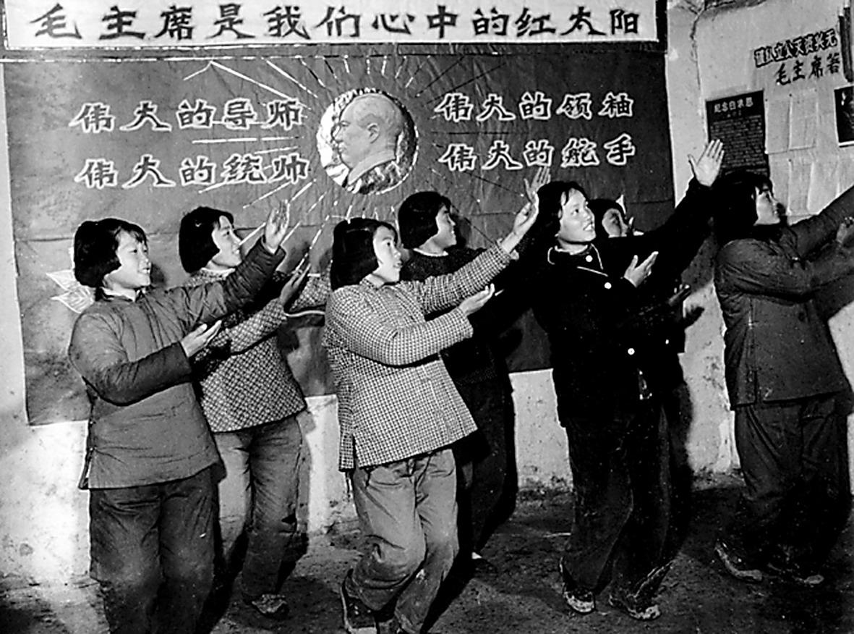
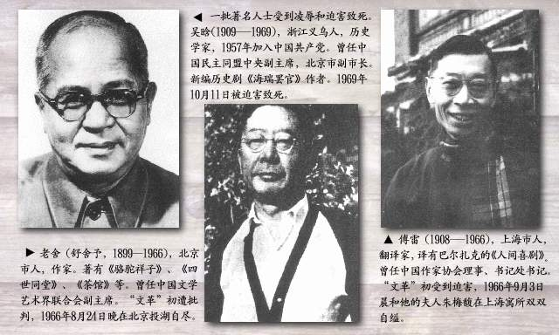
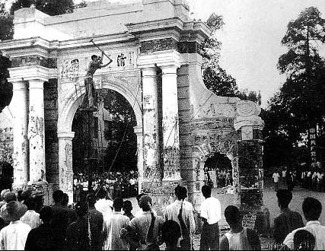
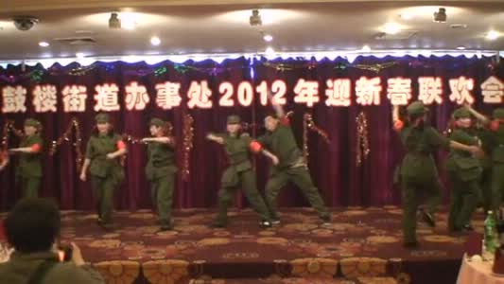
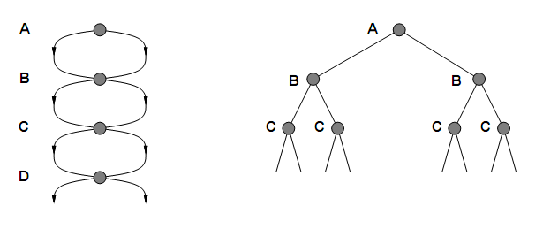
问题：重复状态
如果不能检测重复状态会导致线性问题变成指数型

Slide 45
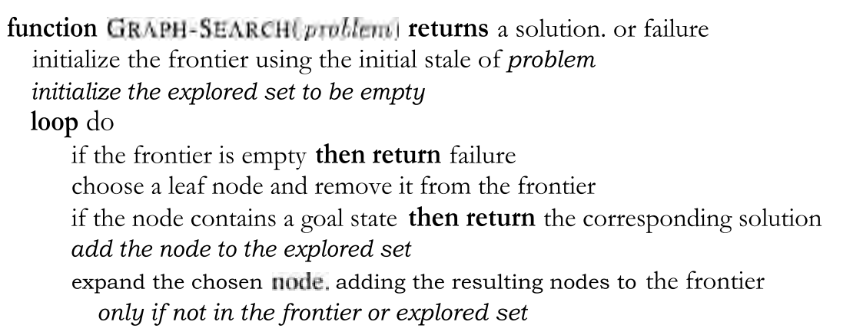
图搜索

Slide 46
搜索策略
搜索策略：
如何选择节点扩展的顺序
搜索策略的评价
完备性:
如果存在一个解的话，总能找到吗？
最优性
总能找到最低耗散值的解吗？
时间复杂度
为了得到解需要花费多少时间
生成的节点数
空间复杂度
在内存中需存储的最大节点数

Slide 47
搜索策略
时间和空间复杂度可以用如下参数度量
b（分支因子）：每个搜索树的最大分支因子
d（最浅目标节点深度）
m（任何路径的最大长度）: 状态空间中任何路径的最大搜索长度 (可能是 ∞)

Slide 48
大纲
问题求解智能体
问题形式化
无信息的搜索
有信息的搜索
博弈论

Slide 49
无信息的搜索策略/盲目搜索
仅仅使用问题定义中可用的信息
广度优先搜索（Breadth-first search ）
代價一致搜索（Uniform-cost search）
深度优先搜索（ Depth-first search ）
深度有限搜索（ Depth-limited search ）
迭代深入深度优先搜索（ Iterative deepening depth-first search ）
双向搜索（ Bidirectional search ）

Slide 50
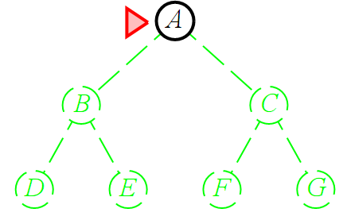
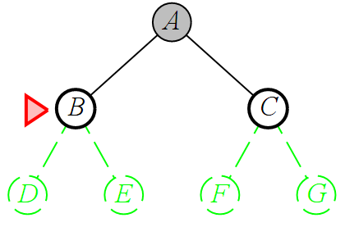
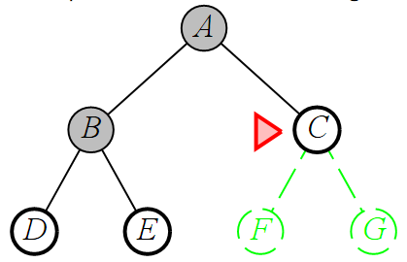
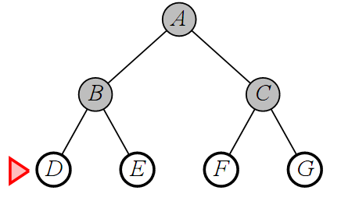
广度优先
FIFO

Slide 51
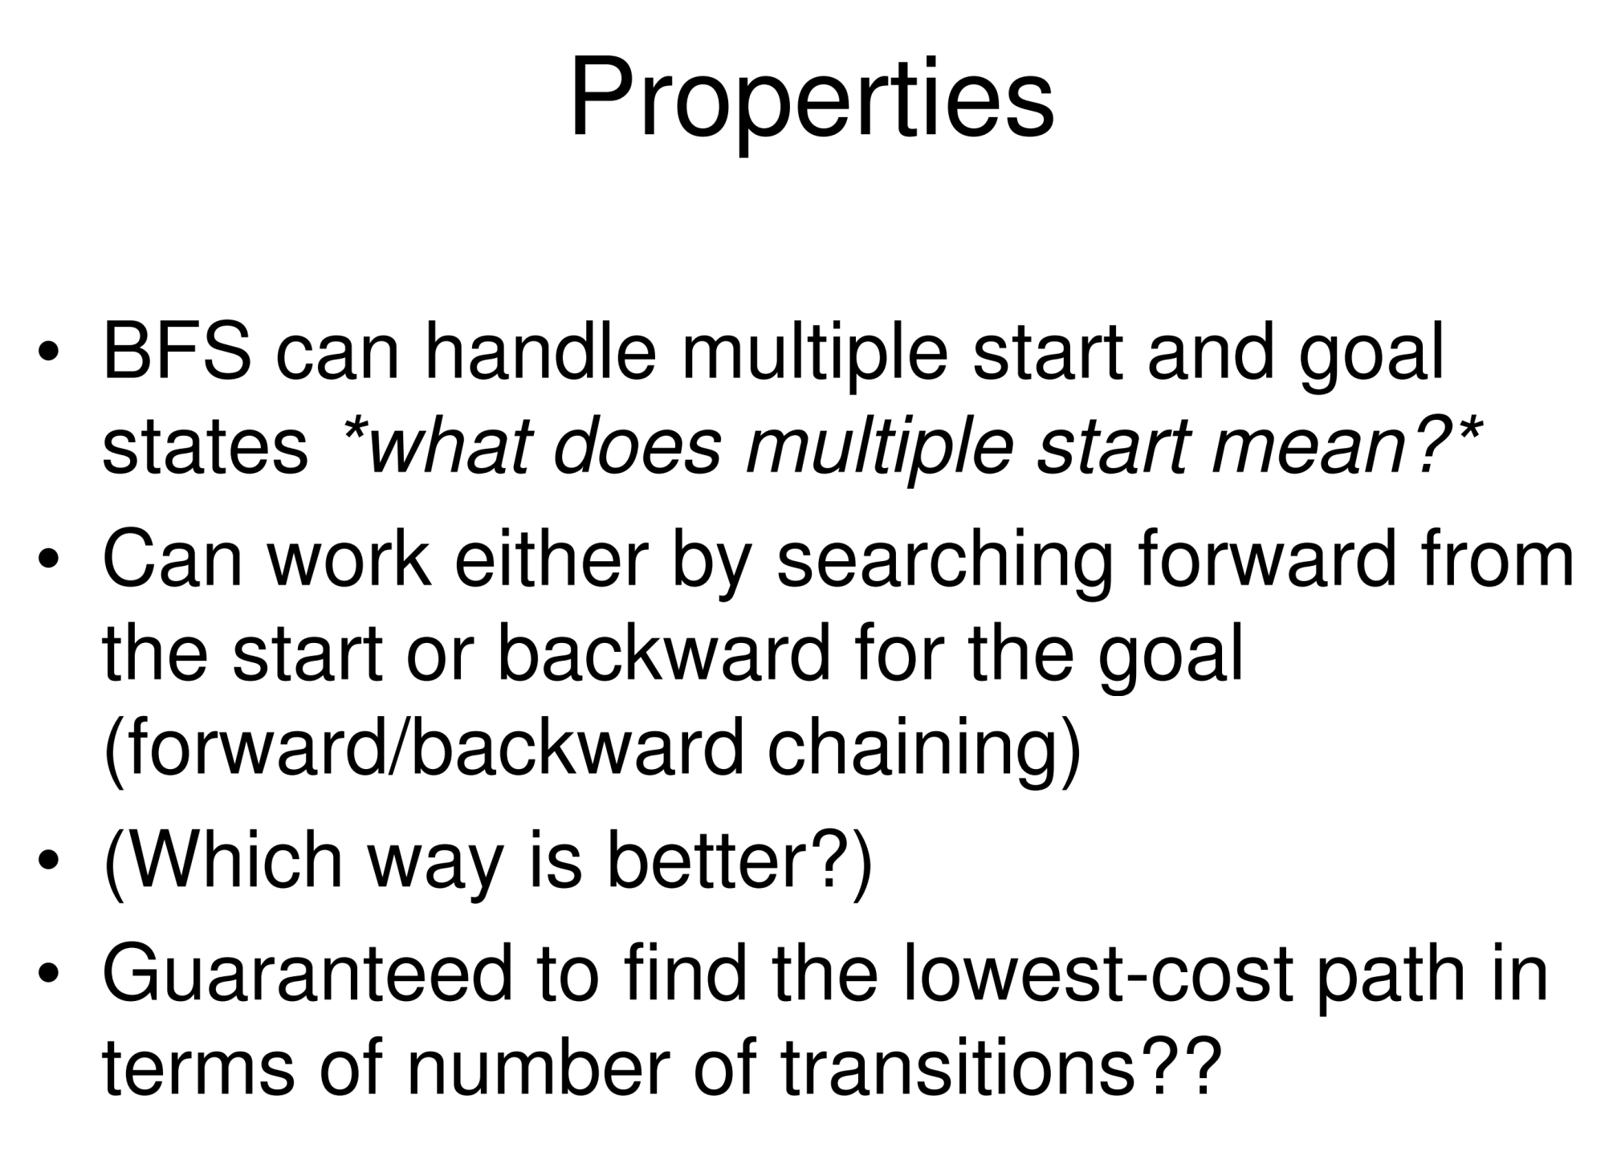

Slide 52
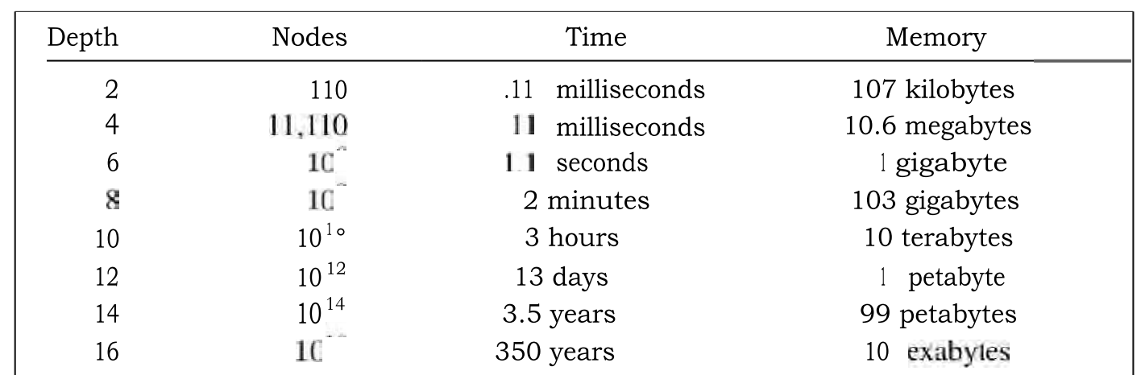
Properties of breadth-first search
Complete? Yes (if b is finite) Time? 1+b+b²+b³+… +b^{d} = O(b^{d}) Space? O(b^{d}) (keeps every node in memory) Optimal? Yes (if cost = 1 per step) Space is the bigger problem (more than time

Slide 53
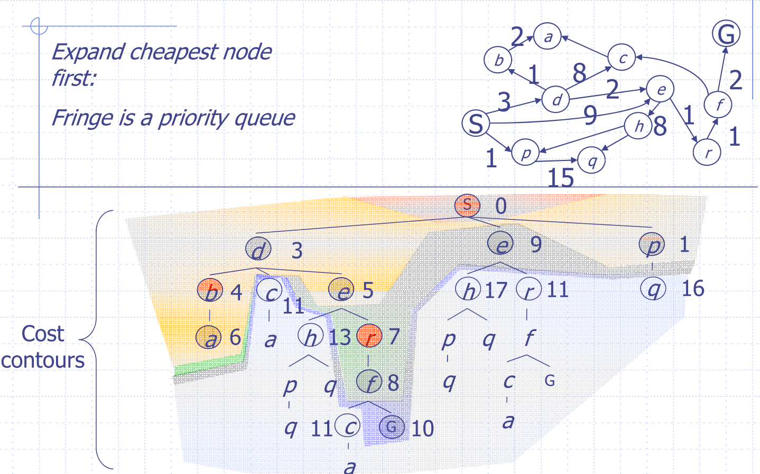
Uniform-cost Search

Slide 54
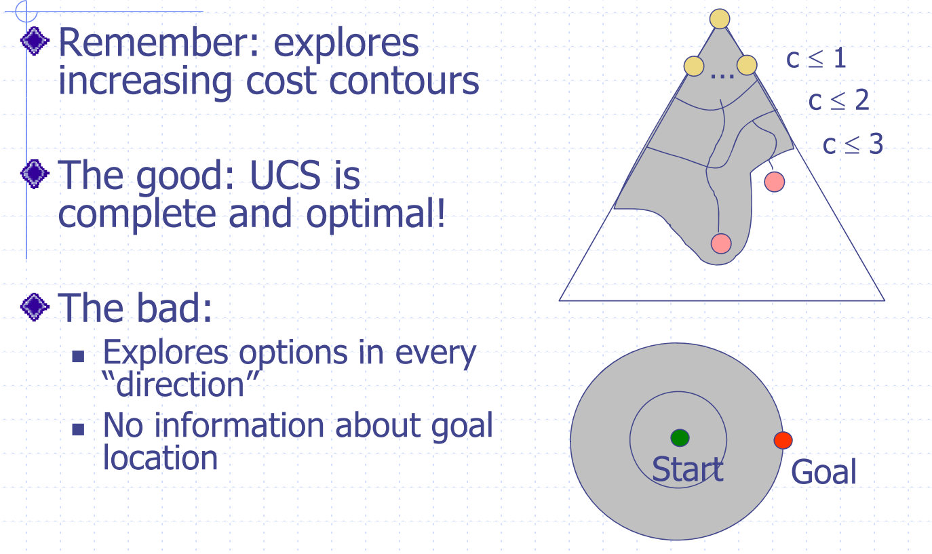
Uniform Cost Issues

Slide 55
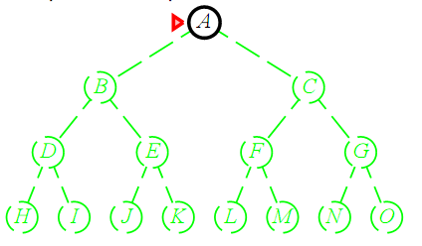
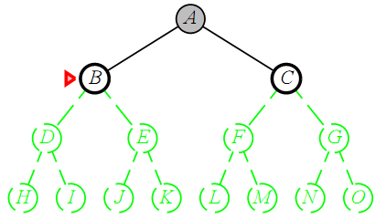
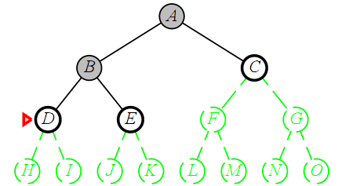
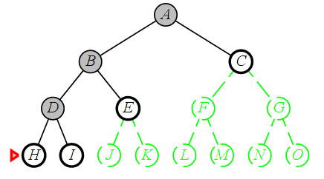
深度优先
LIFO

Slide 56
Properties of depth-first search
Complete?
No: fails in infinite-depth spaces, spaces with loops
Modify to avoid repeated states along path Yes: complete in finite spaces
Time? O(b^{m}): terrible if m is much larger than d
but if solutions are dense, may be much faster than breadth-first
Space? O(bm), i.e., linear space!
Optimal? No

Slide 57
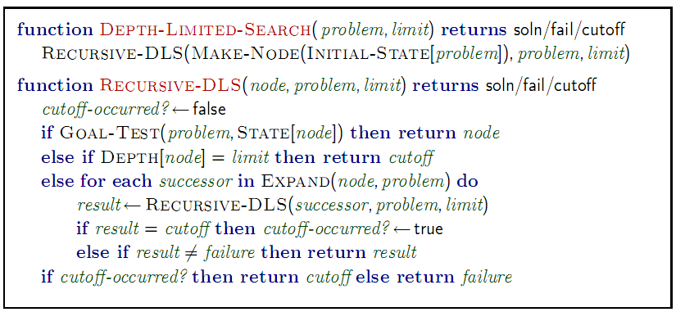
深度有限搜索
深度优先搜索到指定深度 l
深度为 l 的节点不会继续擴展

Slide 58
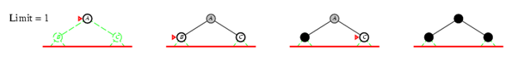
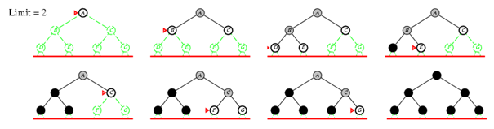
迭代加深深度优先搜索

Slide 59
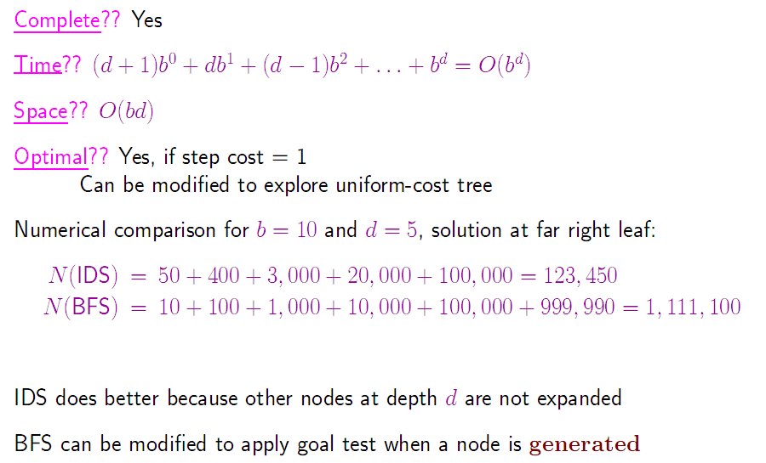
Properties of iterative deepening search
= 111,110

Slide 60
双向搜索
原理： <<

Slide 61
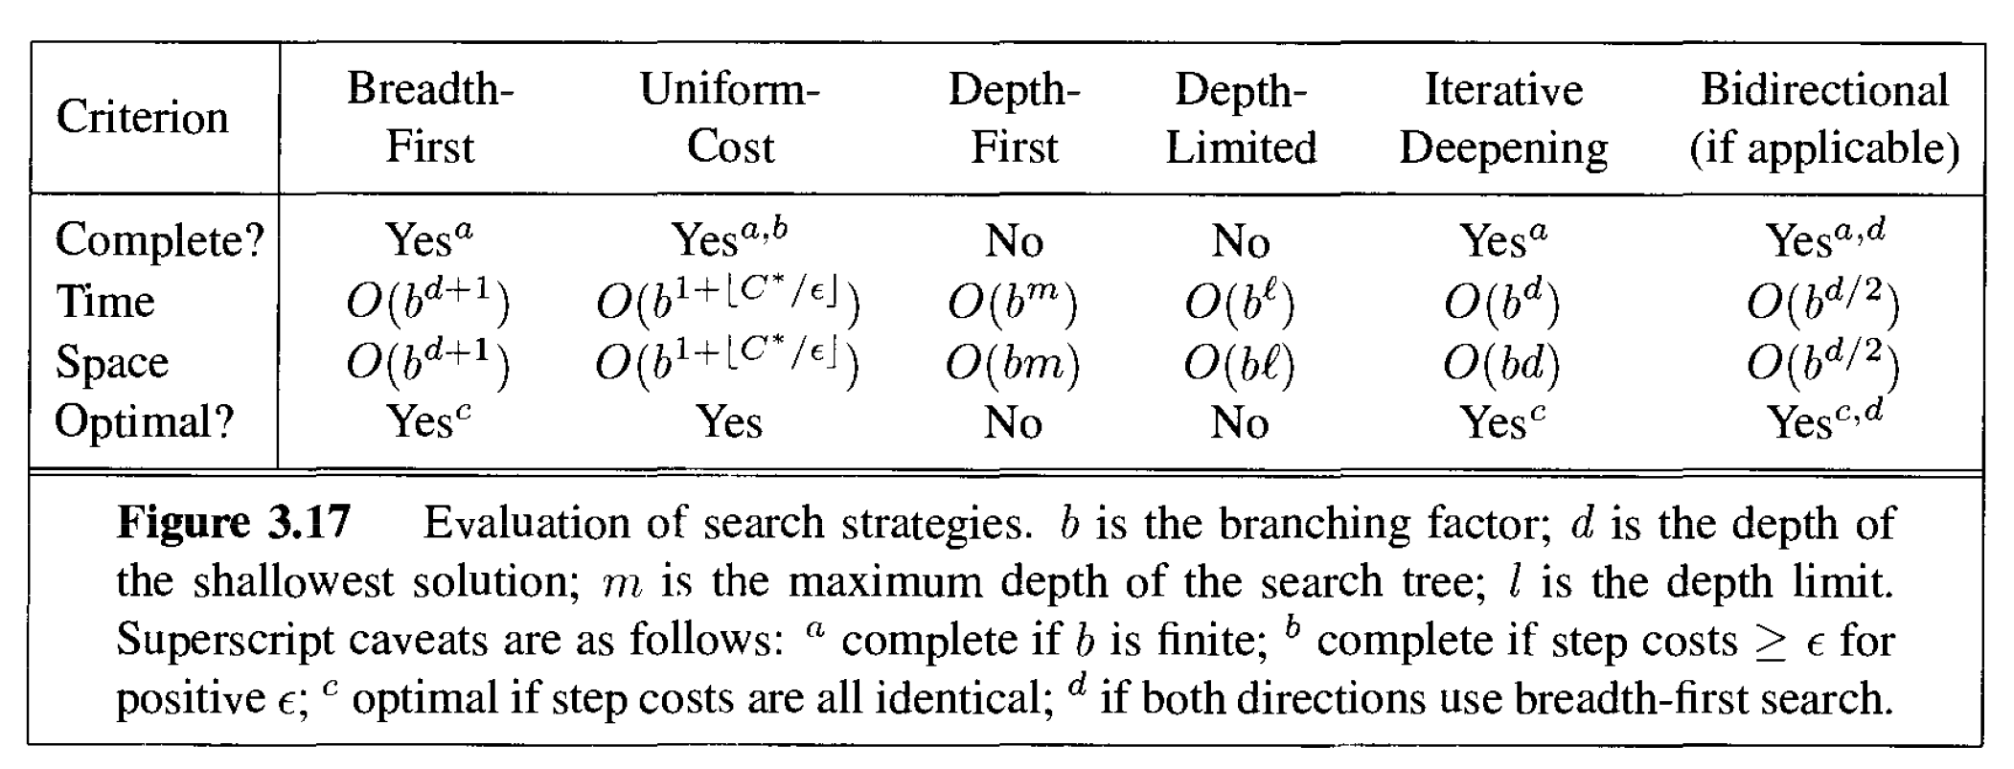
算法小结

